Slide 1
Functions from Formulas – Several Variables
College Algebra

Slide 2
Main Idea
More variables doesn’t make evaluating different
Substitute for each variable in the correct order

Slide 3
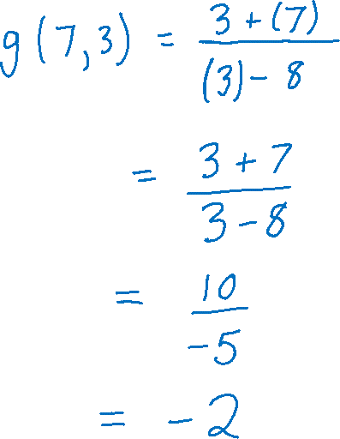



Example 1
Calculate $g\left(7, 3\right)$ if $$g\left(x, y\right)=\frac{3+x }{y−8}.$$

Slide 4
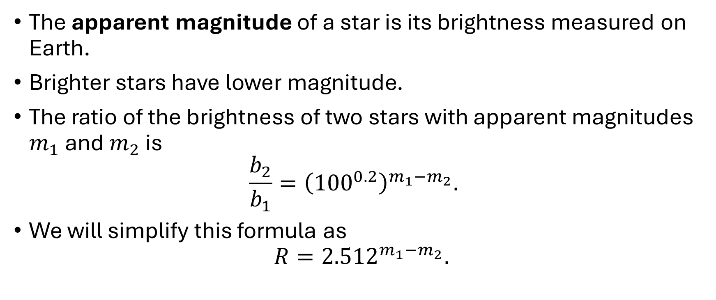
Example 2
The apparent magnitude of a star is its brightness measured on Earth.
Brighter stars have lower magnitude.
The ratio of the brightness of two stars with apparent magnitudes $m_{1}$ and $m_{2}$ is $\frac{b_{2}}{b_{1}}={\left({100}^{0.2}\right)}^{m_{1}−m_{2}}.$
We will simplify this formula as $R={2.512}^{m_{1}−m_{2}}.$

Slide 5

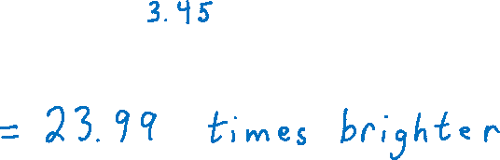
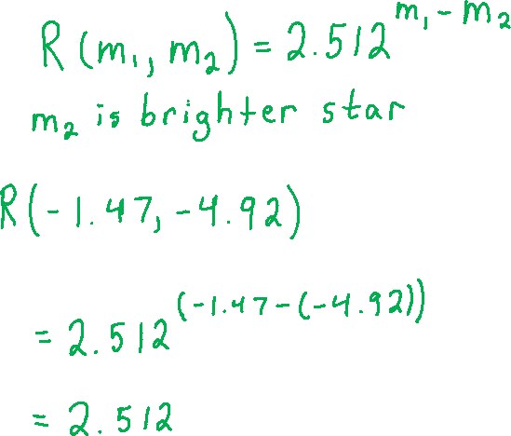


Example 2 (Continued)
The apparent magnitude of Venus is -4.92 at its brightest and the apparent magnitude of Sirius is -1.47. (source: https://en.wikipedia.org/wiki/Apparent_magnitude)
Write the ratio of the brightness of Venus to Sirius in function notation, then calculate the value.

